Slide 2
Product Backlog
A product backlog is a list of the new features, changes to existing features, bug fixes, infrastructure changes or other activities that a team may deliver in order to achieve a specific outcome. The product backlog is the single authoritative source for things that a team works on.

Slide 3
Scrum
Scrum is a framework that helps teams work together. Much like a rugby team (where it gets its name) training for the big game, Scrum encourages teams to learn through experiences, self-organize while working on a problem, and reflect on their wins and losses to continuously improve.
Scrum is a framework within which people can address complex adaptive problems, while productively and creatively delivering products of the highest possible value.
While the Scrum is most frequently used by software development teams, its principles and lessons can be applied to all kinds of teamwork. This is one of the reasons Scrum is so popular. Often thought of as an agile project management framework, Scrum describes a set of meetings, tools, and roles that work in concert to help teams structure and manage their work.

Slide 4
Sprint
a sprint is a set period of time during which specific work has to be completed and made ready for review. The duration of a sprint is determined by the scrum master, the team's facilitator and manager of the Scrum framework.
Each sprint begins with a planning meeting. During the meeting, the product owner (the person requesting the work) and the development team agree upon exactly what work will be accomplished during the sprint. The development team has the final say when it comes to determining how much work can realistically be accomplished during the sprint, and the product owner has the final say on what criteria need to be met for the work to be approved and accepted.

Slide 5
Traditionally, a sprint lasts 30 days.
After a sprint begins, the product owner must step back and let the team do their work. During the sprint, the team holds daily stand-up meetings to discuss progress and brainstorm solutions to challenges. The project owner may attend these meetings as an observer but is not allowed to participate unless it is to answer questions. The project owner may not make requests for changes during a sprint and only the scrum master or project manager has the power to interrupt or stop the sprint.
At the end of the sprint, the team presents its completed work to the project owner and the project owner uses the criteria established at the sprint planning meeting to either accept or reject the work.

Slide 6
Sprint Roles
A variety of roles are involved in a sprint, with each working on different parts of the process. These roles include:
Product owner: This person represents the business or user community and is a liaison between the development team and customers. The product owner is in charge of working with the user group to define, prioritize and adjust what features will be in the product release. They also accept or reject work results and keep customers upraised of the project’s status.
Scrum master: This person is the main facilitator for the project’s development team. They manage the process for how information is exchanged during the sprint, including leading stand-up meetings and helping the team stay on track by mediating problems and removing obstacles. Their main focuses are transparency, observation and organization.
Scrum team: This group of people is responsible for executing the work. In addition to developers, the scrum team can contain testers, architects, designers and IT operations While the scrum master is charged with protecting the team and keeping focus, the team itself is self-managed and ultimately responsible for collectively determining how to reach their goals.

Slide 7
Sprint workflow and process
The sprint workflow is intended to help team members evaluate their work and communicate with each other throughout the entire process. The workflow is followed for each sprint. The process includes:
Backlog - A list of set tasks that must be completed before the product is released. The backlog is built by the product owner. The product owner gives a backlog of prioritized items to the scrum master and scrum team. The backlog is based on user stories, which focus on features that consider the type of end user, what they want and why.
Sprint planning - The team discusses top priority user stories and decides what can be delivered in the sprint.
Sprint backlog - Agreed upon by the entire team, this list finalizes and defines what the development team will complete during the sprint.
Sprint – The time frame in which the work must be completed – often 30 days.
Daily scrum – Lead by the scrum master, the team comes together for short daily meetings, in which they discuss what they have completed, what they are working on and any issues that are blocking the work.
Outcome - The outcome of a sprint is a hypothetically usable product. The product owner can decide if the product is ready or if additional features are needed.
Sprint end - At the end of a sprint, two meetings are held:
Sprint review – The team shows their work to the product owner.
Sprint retrospective – The team discusses what they can do to improve processes. An important goal is continuous improvement.

Slide 8
User Story
A user story is a tool used in Agile software development to capture a description of a software feature from an end user perspective.
The purpose of a user story is to write down how a project will deliver value back to the user. It is then the development team's job to take care of how to develop the code that will satisfy the requirements of the user story. In best-case scenarios, developers collaborate closely with the business owners and stakeholders to clarify the details as the code gets developed.
The end result is “As a <who>, I want <what> so that <why>.” Further detail can be added to a user story by breaking it into smaller user stories and grouping them into themes.

Slide 9
Burn Down Chart
A burn down chart is a visual representation of the amount of work that still needs to be completed before the end of a project. A burn down chart has a Y axis (work) and an X axis (time). Ideally, the chart illustrates a downward trend as the amount of work still left to do over time "burns down" to zero.
A burn down chart provides both project team members and business owners with a common view of how work is proceeding.

Slide 10
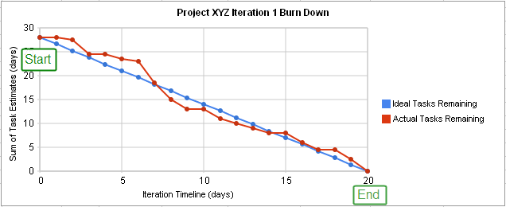

Slide 11
Manifesto for Agile Software Development
We are uncovering better ways of developing
software by doing it and helping others do it.
Through this work we have come to value:
Individuals and interactions over processes and tools
Working software over comprehensive documentation
Customer collaboration over contract negotiation
Responding to change over following a plan
That is, while there is value in the items on
the right, we value the items on the left more.

Slide 12
Kent Beck
Mike Beedle
Arie van Bennekum
Alistair Cockburn
Ward Cunningham
Martin Fowler
James Grenning
Jim Highsmith
Andrew Hunt
Ron Jeffries
Jon Kern
Brian Marick
Robert C. Martin
Steve Mellor
Ken Schwaber
Jeff Sutherland
Dave Thomas

Slide 13
Cloud Computing
Cloud computing can be referred to as the storing and accessing of data over the internet rather than your computer's hard drive. This means you don't access the data from either your computer's hard drive or over a dedicated computer network (home or office network). Cloud computing means data is stored at a remote place and is synchronized with other web information.
One prominent example of cloud computing is Office 365 which allows users to store, access, edit their MS Office documents online (in browser) without installing the actual program on their device.

Slide 14
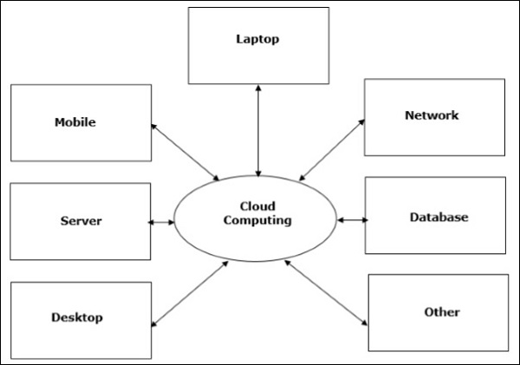

Slide 15
Types of Cloud
The storage options on cloud is in 3 forms −
Public Cloud − A service provider makes the clouds available to the general public which is termed as a public cloud. These clouds are accessed through internet by users. These are open to public and their infrastructure is owned and operated by service providers as in case of Google and Microsoft.
Private Cloud − These clouds are dedicated to a particular organization. That particular organization can use the cloud for storing the company's data, hosting business application, etc. The data stored on private cloud can't be shared with other organizations. The cloud is managed either by the organization itself or by the third party.
Hybrid Cloud − When two or more clouds are bound together to offer the advantage of both public and private clouds, they are termed as Hybrid Cloud. Organizations can use private clouds for sensitive application, while public clouds for non-sensitive applications. The hybrid clouds provide flexible, scalable and cost-effective solutions to the organizations.

Slide 16
Benefits of Cloud
There are many benefits of clouds. Some of them are listed below.
Cloud service offers scalability. Allocation and de-allocation of resources is dynamically as per demand.
It saves on cost by reducing capital infrastructure.
It allows the user to access the application independent of their location and hardware configuration.
It simplifies the network and lets the client access the application without buying license for individual machine.
Storing data on clouds is more reliable as it is not lost easily.

Slide 17
SPI – Service Categorization
Saas - stand for Software, is Software as a service
Paas - stands for Platform, PaaS is Platform as a service
Iaas - stands for Infrastructure, IaaS is Infrastructure as a Service.
Following are the live examples of these models.
SAAS Model − E-mail (Gmail, Yahoo, etc.)
PAAS Model − Microsoft Azure
IAAS Model − Amazon S3

Slide 18
SAAS | INVOICING, ACCOUNTING, YAHOO, GMAIL | SAAS
PAAS | OS, FRAMEWORK, DB, WEB SERVER | PAAS
IAAS | FIREWALL, VM, RAM, ROUTERS, CPU,NW | IAAS

Slide 19
